Slide 1
Networking and the internet
Lesson 1: IP addressing and switches

Slide 2
Objectives
In this lesson, you will learn:
the format for an IP address
the purpose of an IP address
the difference between public and private IP addresses
the purpose and function of a switch.

Slide 3
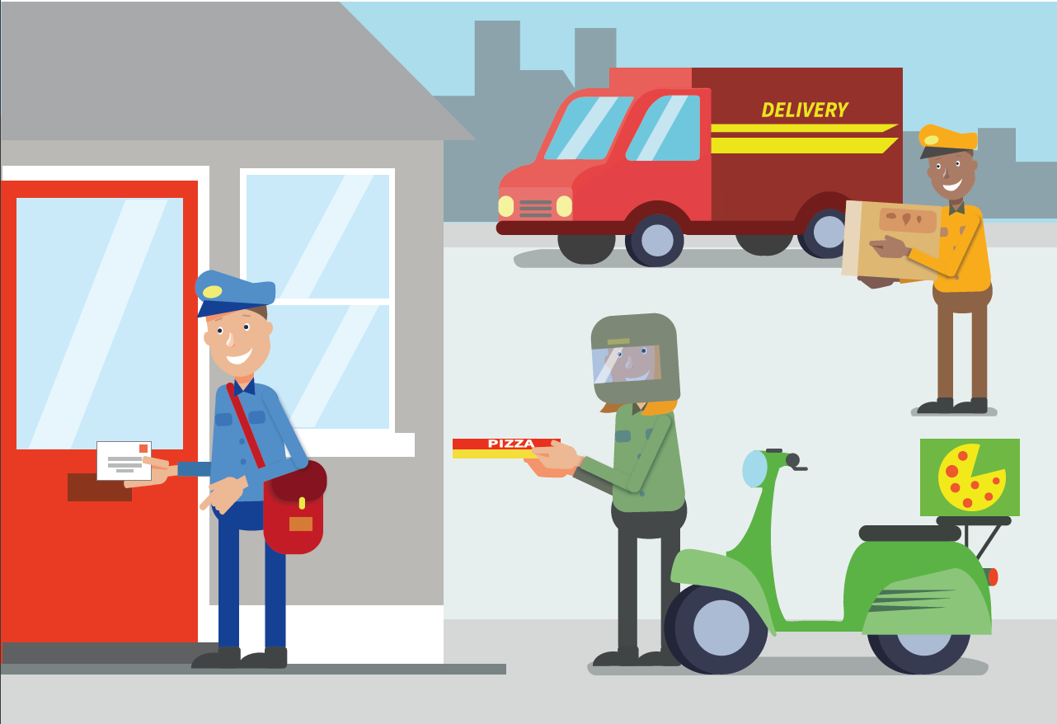
Addresses are important
Postal workers and delivery drivers need to know your address to be able to deliver post and parcels to your home.
Other than your home address, what other ‘addresses’ do you have?

Slide 4
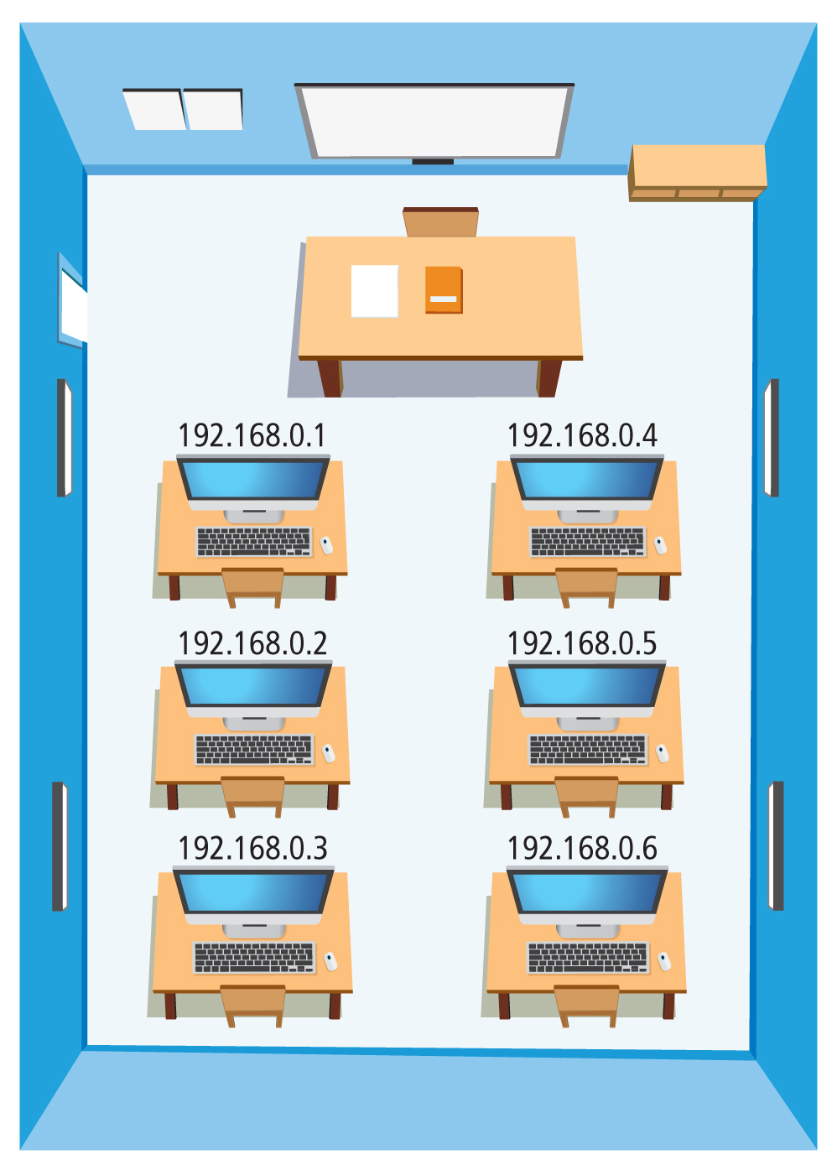
IP addresses
Each device on a network has a unique IP address, just like each home has a unique address and each phone has a unique phone number, so that data can be sent to the correct place.

Slide 5
Rules for IP addresses
‘IP’ stands for ‘Internet Protocol’. A protocol is a set of rules, and the Internet Protocol is a specific set of rules for how to transmit data from one device to another.
All IP addresses must contain four numbers between 0 and 255, separated by full stops.
For example:
217.83.0.12

Slide 6
Invalid IP addresses
What is the problem with these IP addresses?
83.12.217.0.162
217.83.12
217.83.0.256

Slide 7

Activity 1.1: IP address format
Complete Interactive 1.1

Slide 8
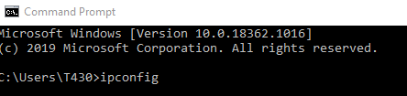
Finding your IP address on a Windows computer
Press the Windows key and type cmd to open the Command Prompt (CMD).
Type the command ipconfig and press the Return key.

Slide 9
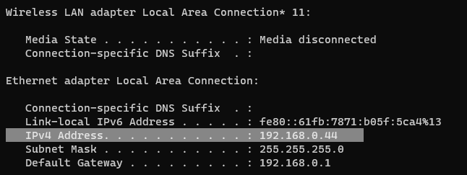
Finding your IP address on a Windows computer
3. Look for your IPv4 address.

Slide 10
Finding your IP address on a MacOS computer or a Linux computer
Go to the Utilities folder inside the Applications folder and open the Terminal application.
Type the command ipconfig getifaddr en0 and press the Return key.

Slide 11
Public and private IP addresses
The IP protocol allows for a little over 4 billion possible IP addresses. This means there are not enough IP addresses for every device in the world.
Consequently, IP addresses are divided into public IP addresses and private IP addresses.
Public IP addresses are unique and allow devices to access the internet directly.

Slide 12
Public and private IP addresses
Private IP addresses allow devices to connect to the network, which then connects to the internet.
Private IP addresses work like an internal phone network with extension numbers. Two different networks can use the same private IP addresses, reducing the need for unique IP addresses.
Private IP addresses start with one of the following numbers:
192.168.x.x (usually used for home networks)
172.x.x.x (typically used for larger networks, like a home or school network)
10.x.x.x (typically used for larger networks, like a home or school network).

Slide 13
Activity 1.2: Public or private?
Complete Interactive 1.2

Slide 14
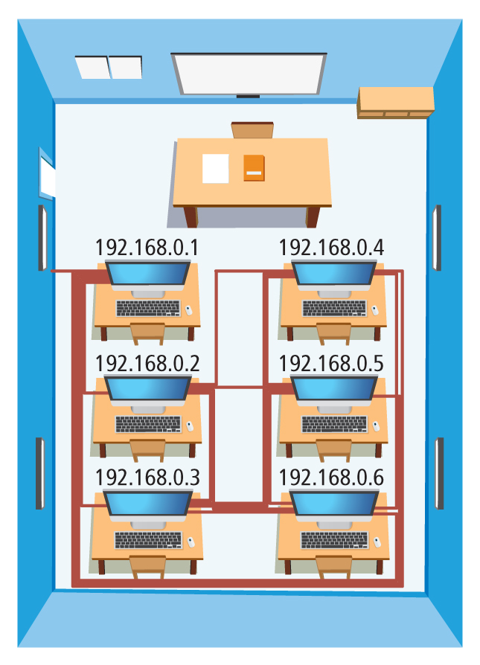
Network hardware
Devices on a network need to connect to each other. But, if they connected to each other directly, we would need A LOT of cable.

Slide 15
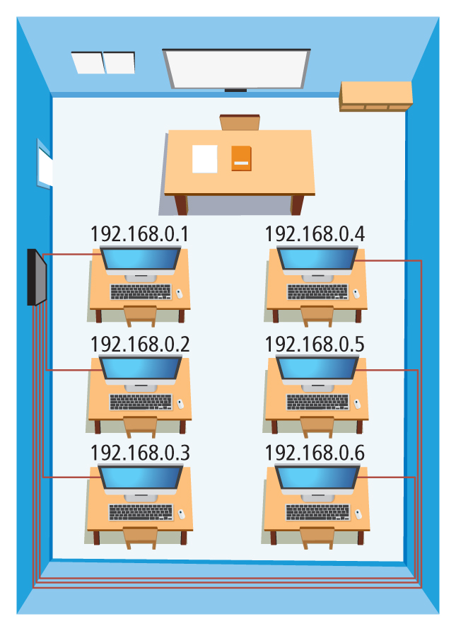
Switches
We use a switch to connect the devices on a network.
Data is sent from a device to the switch. The switch reads the destination IP address of the data and sends it to the right device.
Large networks may have more than one switch and the data passes through more than one switch on its way to the destination IP address.

Slide 16
Routers and public and private IP addresses
If the destination IP address is a public IP addresses, the switch passes the data to the internet connection.
If the destination IP address is a private IP address, the switch passes the data directly to the device.

Slide 17
Activity 1.3: Switch game
Complete Interactive 1.3

Slide 18
Activity 1.4: Toppers (Part 1)

Slide 19
Quiz 1

